Slide 1

Department of Computer Science and Engineering
(Cyber Security)
WEB PROGRAMMING MINI PROJECT
PAWADOPT - ADOPT PETS THAT NEED A HOME
NAME: NANDHINI VELMURUGAN
REG NO: 2116241901063

Slide 2
ABOUT THE PROJECT
PawAdopt is a responsive web platform that connects people who want to adopt with verified rescue pets.
Users can browse dogs, cats, birds and other companions, view their health status and personality, and find them on a map.
Shelters and individuals can list a pet for adoption through a simple online form.
It has a dark, modern interface with live adoption statistics and a clear four-step adoption journey.

Slide 3
PROBLEM STATEMENT / OBJECTIVE
Pet adoption information is scattered across social media, word of mouth and outdated shelter websites.
Adopters struggle to find trusted details such as vaccination status, location and adoption availability.
Shelters have no simple way to list animals and track their status.
Build one platform where adopters can discover rescued pets easily.
Provide search, filters and sorting so users can find the right match quickly.
Show verified medical details (vaccinated, spayed/neutered, microchipped) to build trust.
Let shelters list pets and update their status: Ready, Pending or Adopted.
Show pet locations on an interactive map.

Slide 4
TOOLS AND TECHNOLOGIES
CATEGORY | TECHNOLOGY
Structure | HTML5
Styling | CSS3 (Flexbox, Grid, gradients, responsive design)
Logic | JavaScript (DOM manipulation, filtering, form handling)
Map | Leaflet.js with OpenStreetMap tiles
Typography and Icons | Google Fonts, SVG icons, emojis
Data Storage | JavaScript objects / browser storage (update this if you used a database)
Editor | VS Code

Slide 5
IMPLEMENTATION
Home page: The hero section shows the tagline “Find Your Forever Companion” with Browse and List a Pet buttons, plus live stats: Ready for Adoption, Pending Inquiries, Happily Adopted and 100% Health Vetted.
Search and filters:
  Keyword search by breed, personality or “good with kids”.
  Size dropdown and sort options such as Recently Added.
  Status tabs: All, Ready to Adopt, Pending and Adopted.
  Species filters: Dogs, Cats, Birds and Others.
Pet cards: Each card shows the photo, status badge, adoption fee, species, age, gender, breed, health tags and personality traits.
Shelter map: Leaflet displays colour-coded markers: purple for Available, orange for Application Pending and green for Adopted.
List a Pet form:
  Fields for breed, gender, age, size, fee and shelter location.
  Health verification checkboxes and personality traits.
  A rescue story and a photo upload.
Why Adopt section: It highlights four promises: 100% Medical Vetted, 2-Week Trial Foster, Direct Foster Chat and Lifetime Support.

Slide 6
OUTCOME
A fully working, responsive pet adoption website with a consistent dark UI.
Users can search, filter and sort pets in real time, with no page reload.
Pets can be viewed as cards or on a map, and new pets can be added through the form.
Status-based colour coding makes availability clear at a glance.
The interface is simple, trustworthy and easy to navigate.

Slide 7
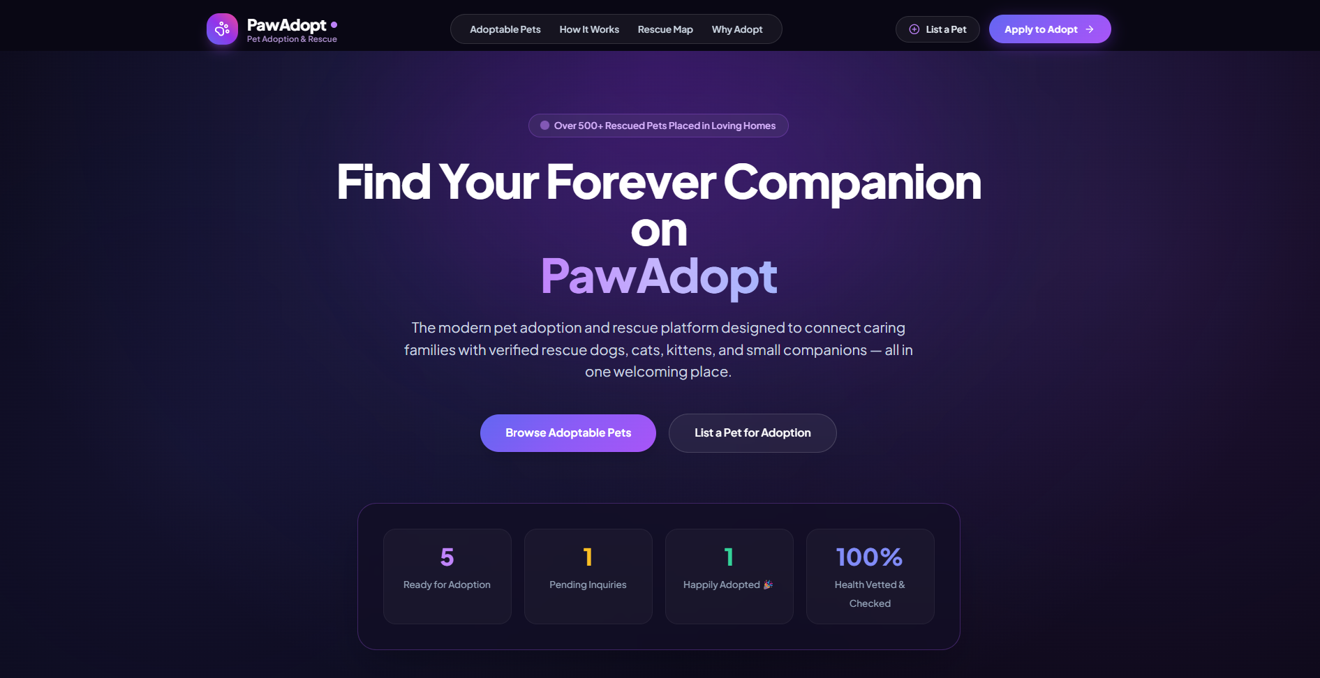
PROTOTYPE

Slide 8
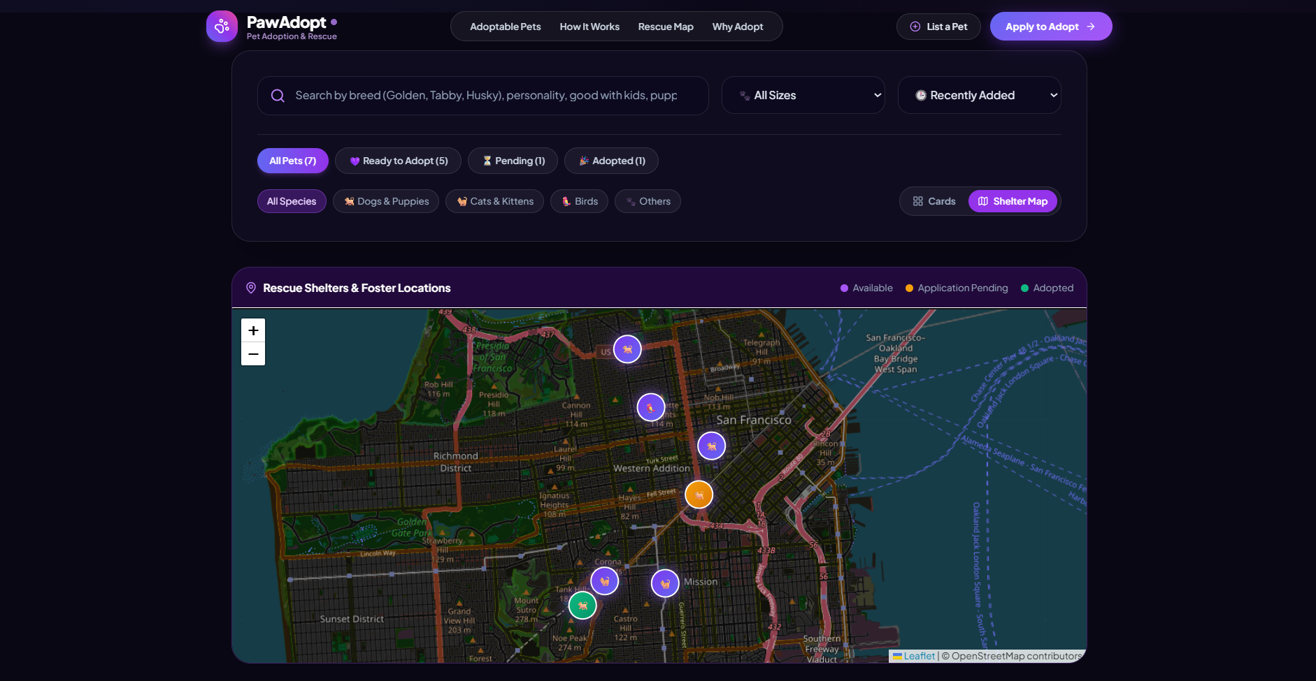
PROTOTYPE

Slide 9
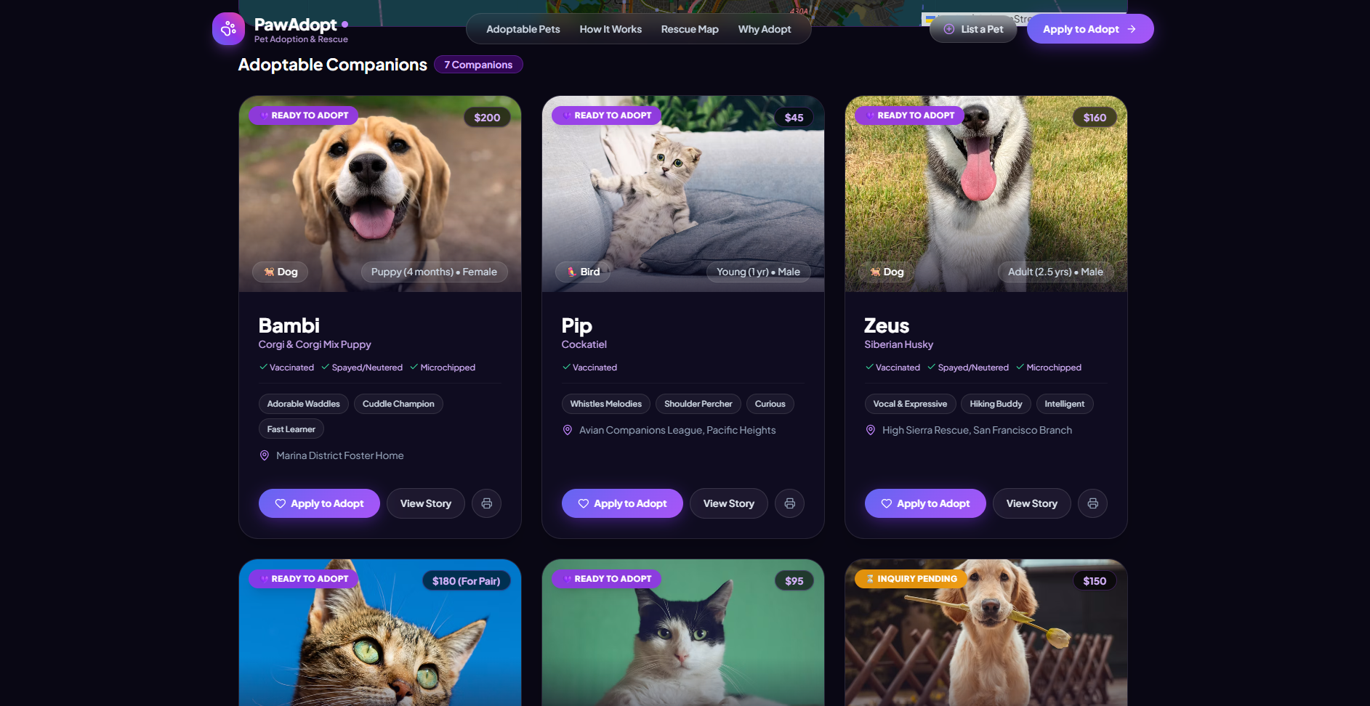
PROTOTYPE

Slide 10
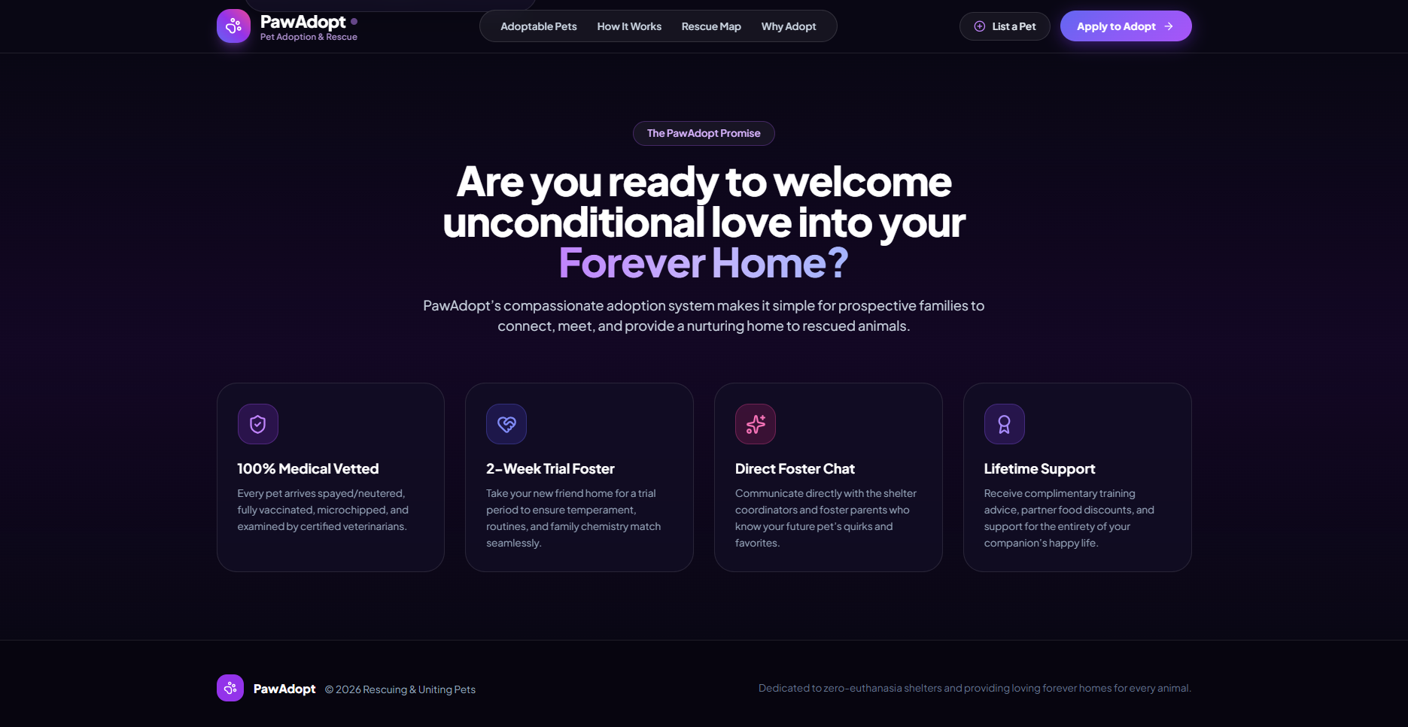
PROTOTYPE

Slide 11
CONCLUSION
PawAdopt turns a scattered, manual adoption process into one organised and accessible platform.
It combines search, health verification, mapping and pet listing in a single place.
The project let me apply core web programming concepts: semantic HTML, responsive CSS, DOM manipulation, event handling, form validation and third-party map integration.
It supports responsible adoption by making trusted information easy to find.

Slide 12
FUTURE SCOPE
User login and registration for adopters and shelters.
A backend and database (Node.js/Express with MongoDB or MySQL) for permanent storage.
Online adoption application forms with admin approval.
A real-time chat between adopters and foster coordinators.
Email or SMS notifications when an application status changes.
A favourites list and a “pets near me” feature using GPS.
A mobile app version, plus donation and volunteer modules.

